Slide 1
Feasibility Check Snap

Slide 2
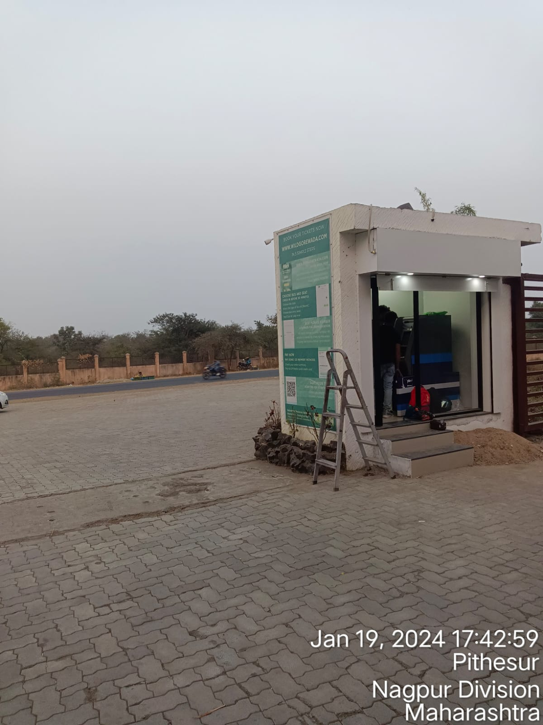
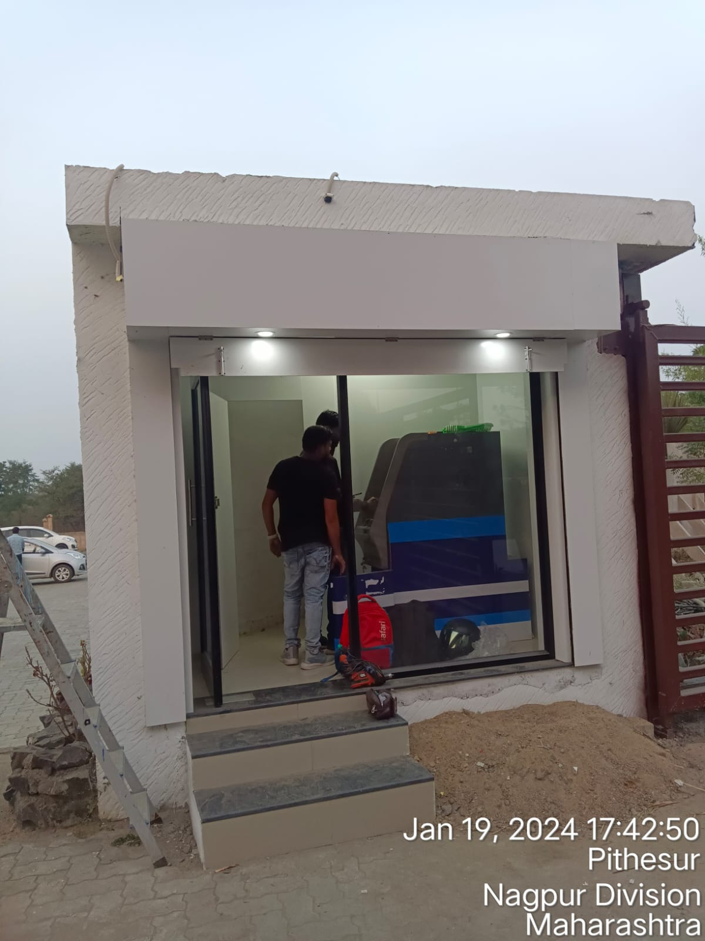
1. ATM Entrance Snap

Slide 3
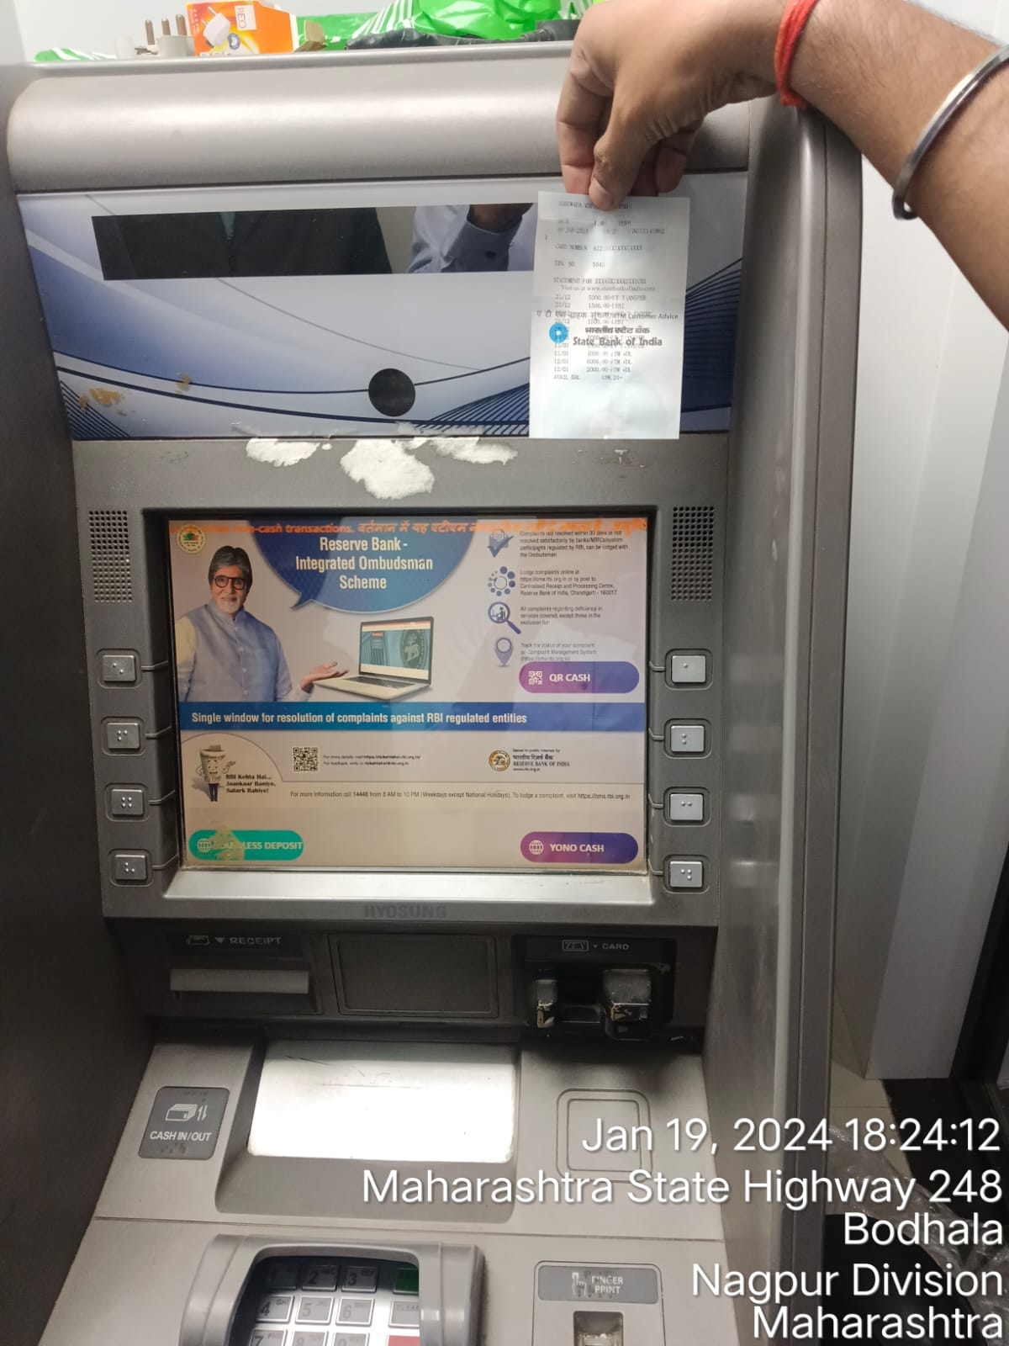
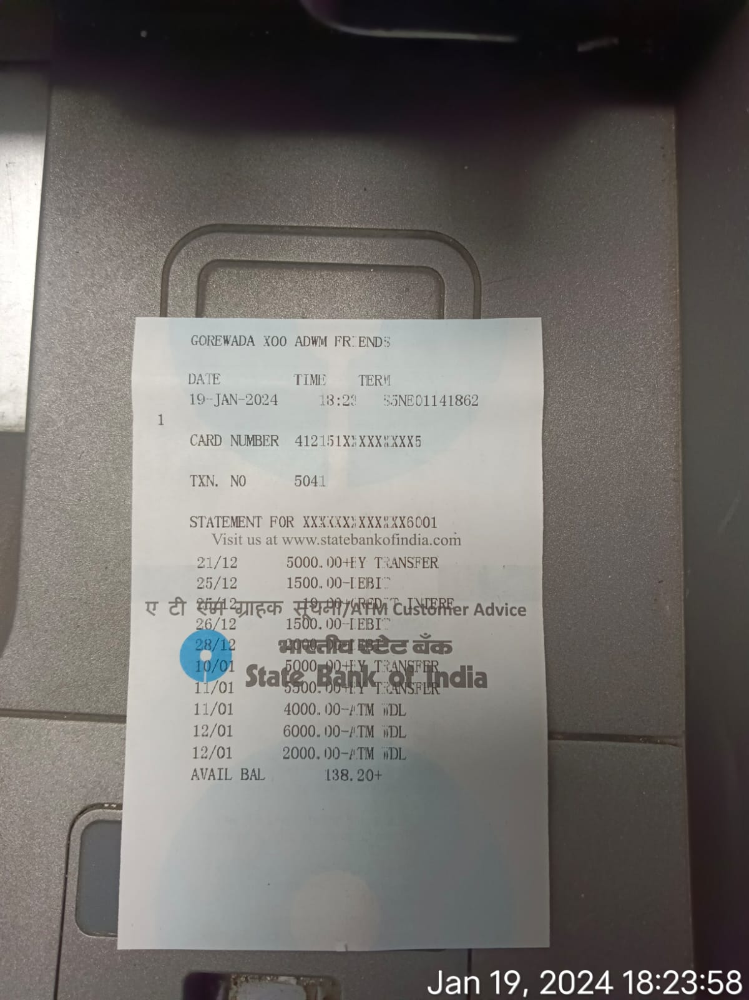
2. ATM ID and Machine Snap

Slide 4
3. If 2nd ATM Available
Not available

Slide 5
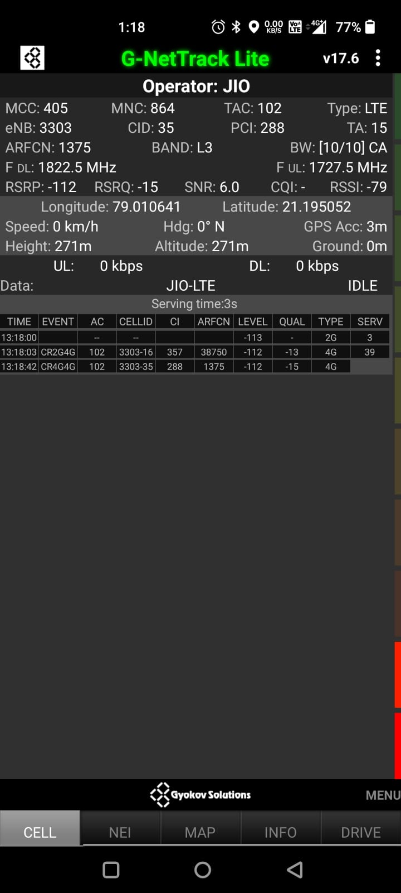
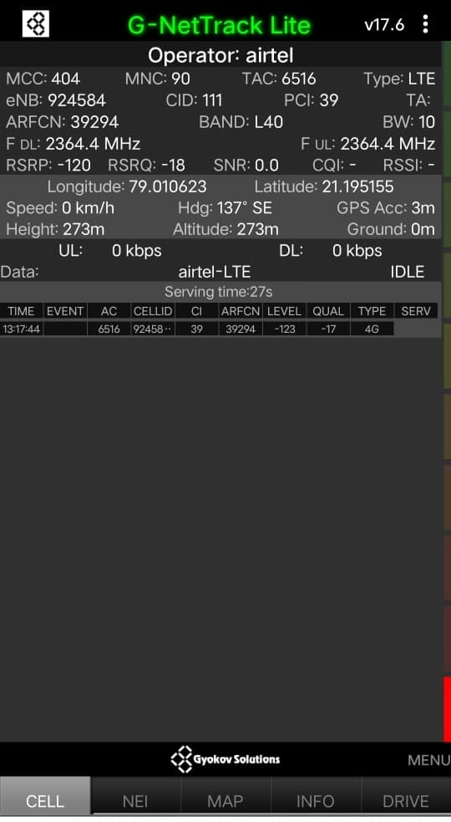
4. Network Snap (Airtel, Jio & Vi) (Application Name:- G-net)

Slide 6
5. UPS with Battery Snap
Not Install at site.

Slide 7
6. UPS Snap
NO Install at site

Slide 8
7. UPS Display Snap
UPS & batteries are not available.

Slide 9
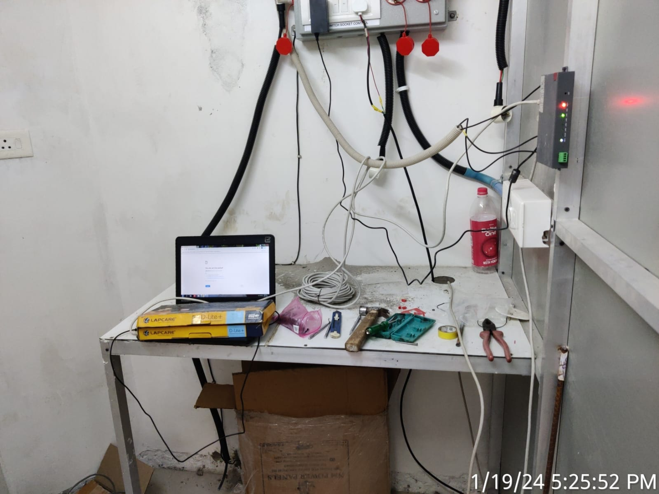
8. Router Installation Place Snap

Slide 10
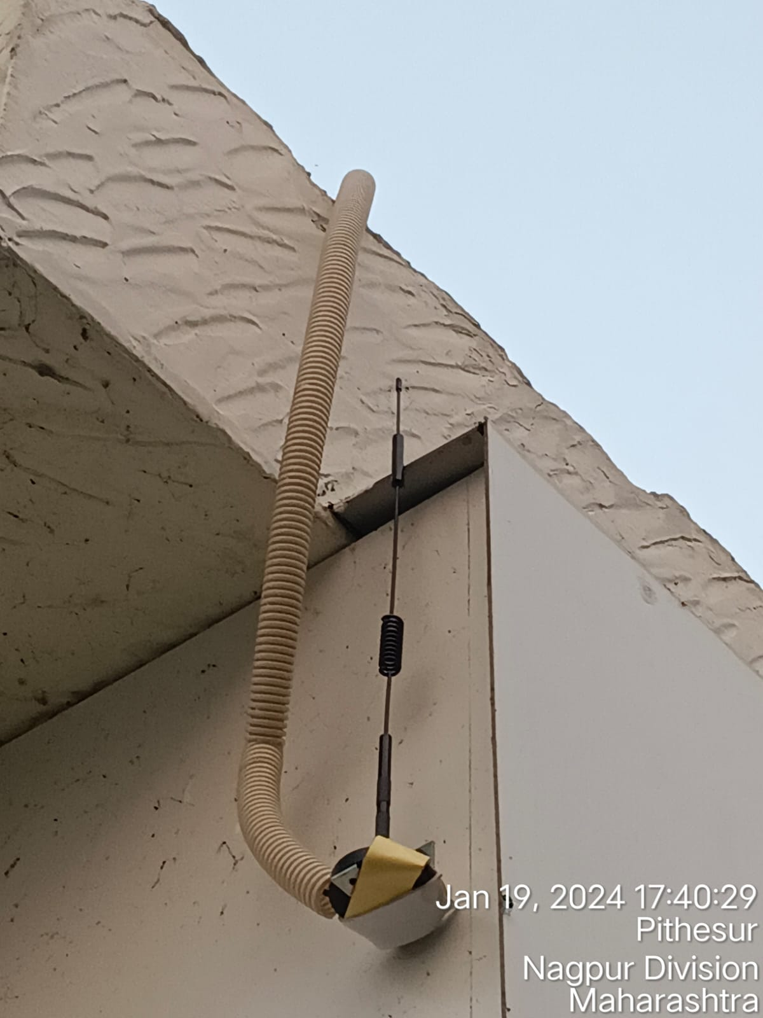
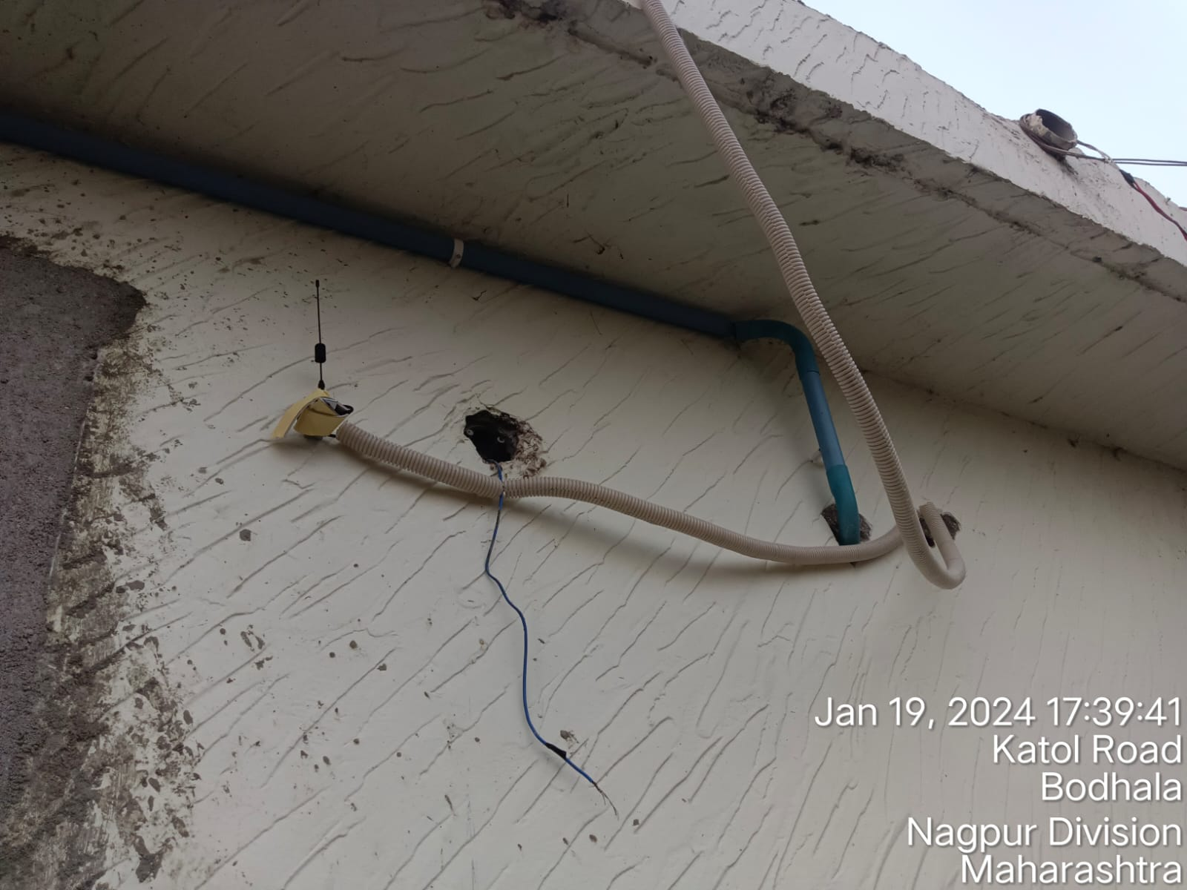
9. Antenna Installation Place Snap

Slide 11
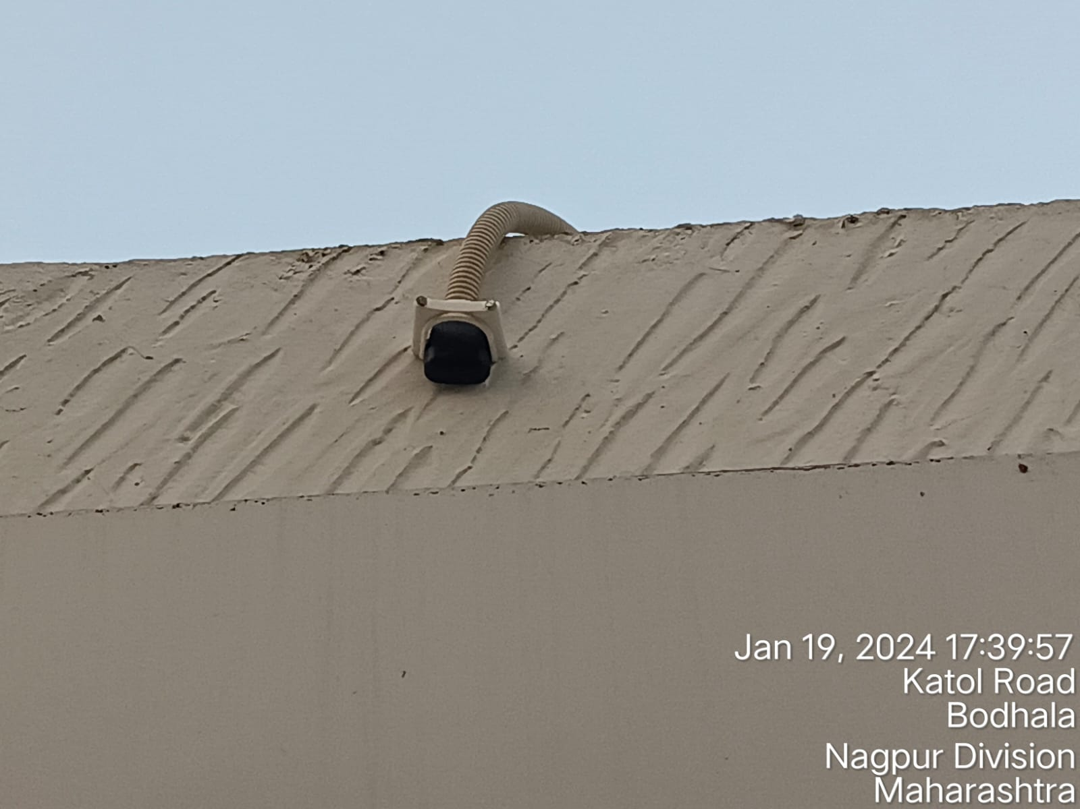
10. GPS Installation Place Snap

Slide 12
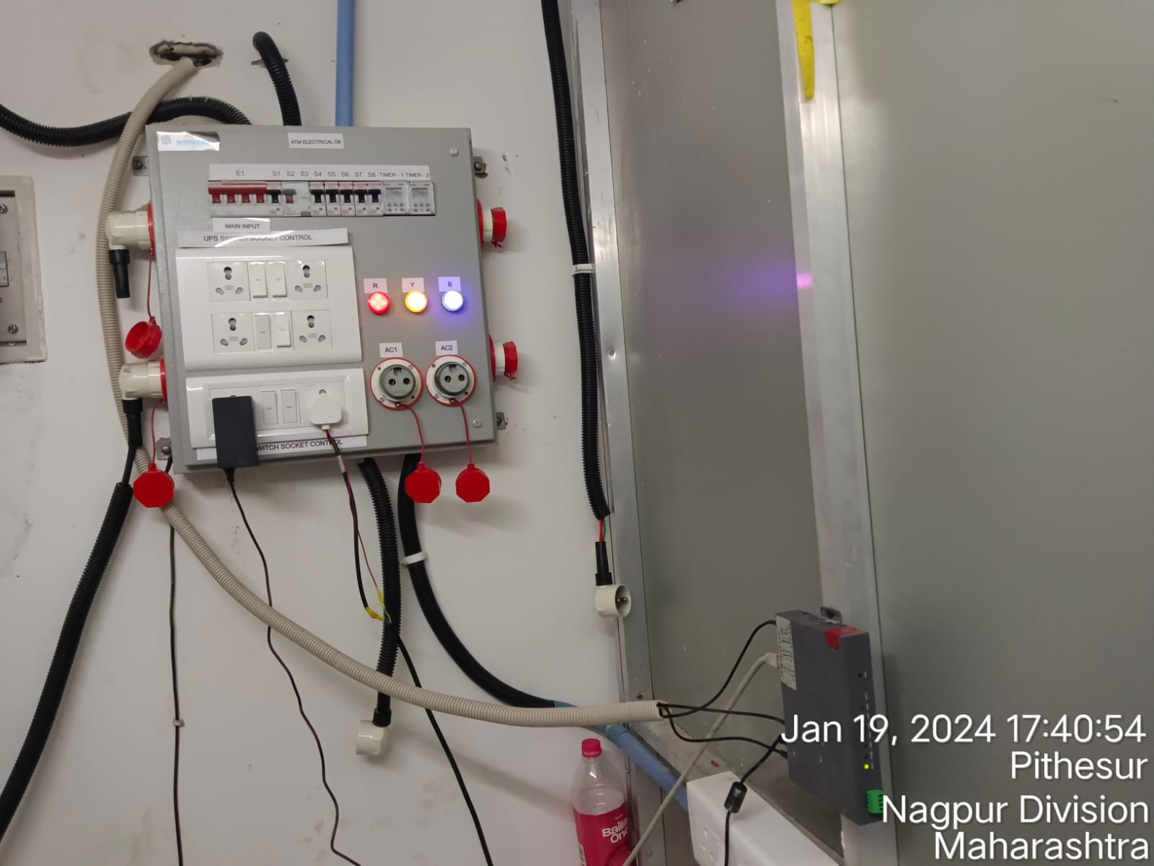
11. Router Cabling Snap

Slide 13
12. DB Socket Available Snap

Slide 14
13. UPS Socket Available Snap

Slide 15
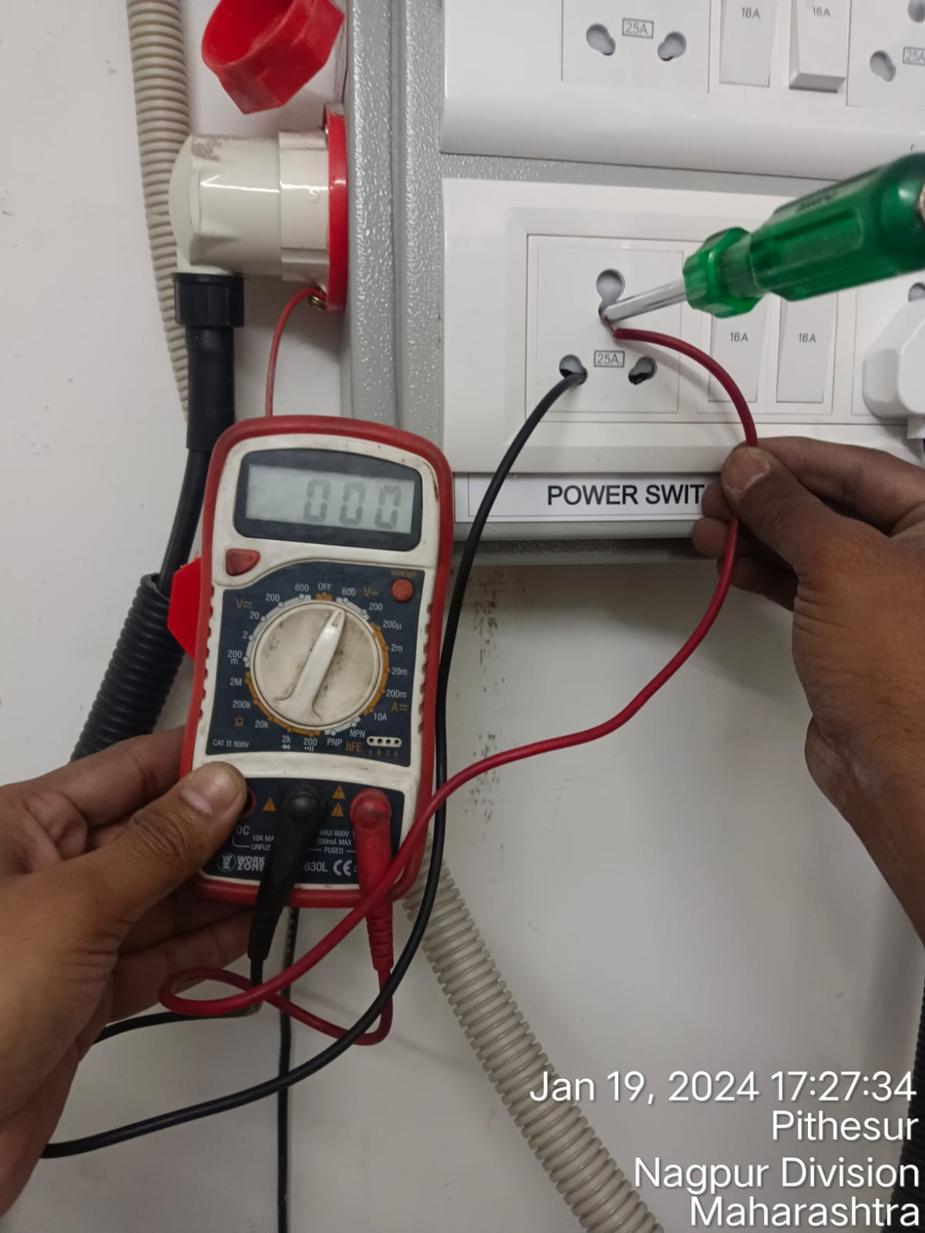
14. Earthing Snap (NE)

Slide 16
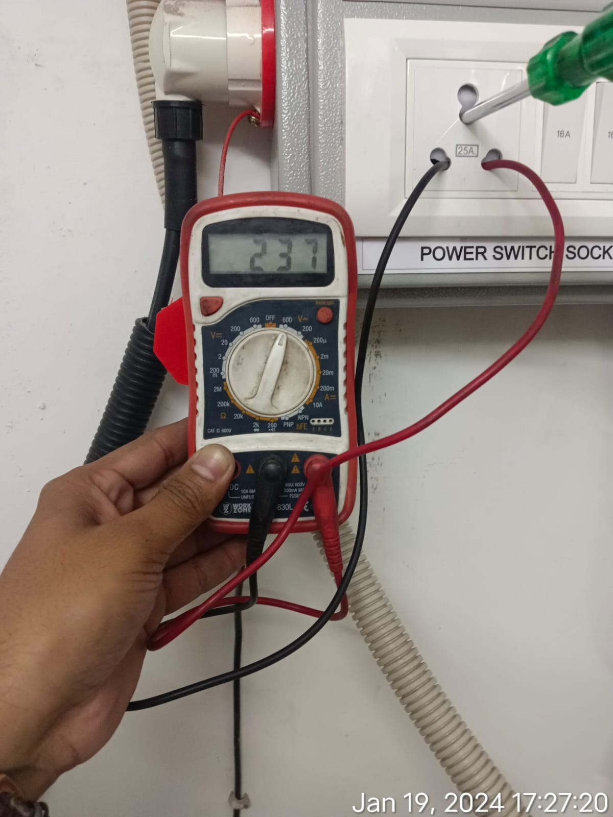
15. Power Snap (PN)

Slide 17
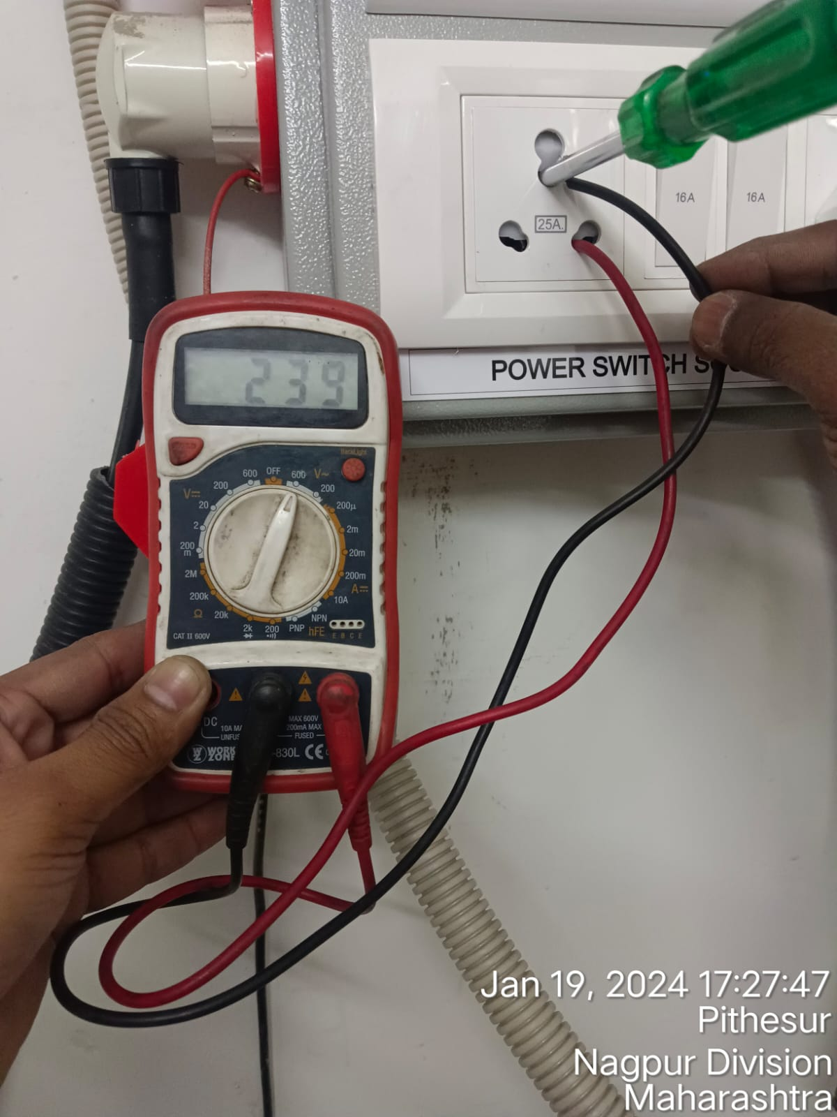
16. Power Snap (PE)

Slide 18
17. Lobby Snap

Slide 19
18. Contact Details
1) Housekeeper Name And Contact Number
2) Backroom Key person Name and Contact Number
3) Near Electronic Shop Name and Contact Number

